Slide 1
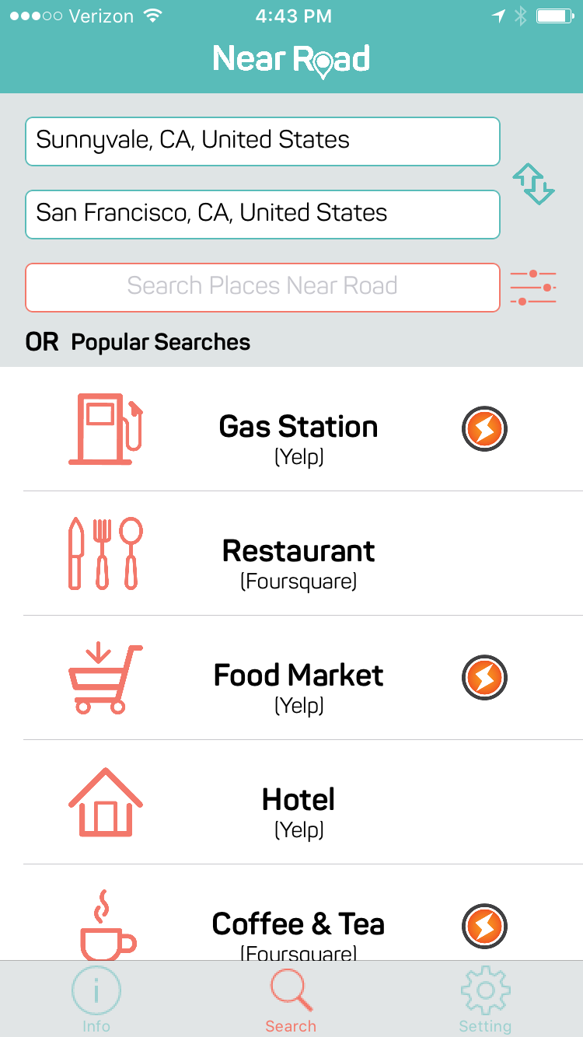
1, User can specify starting location(or current location), destination and the kind of stops they are interested(such as gas station, Restaurant, hotel etc.).

Slide 2
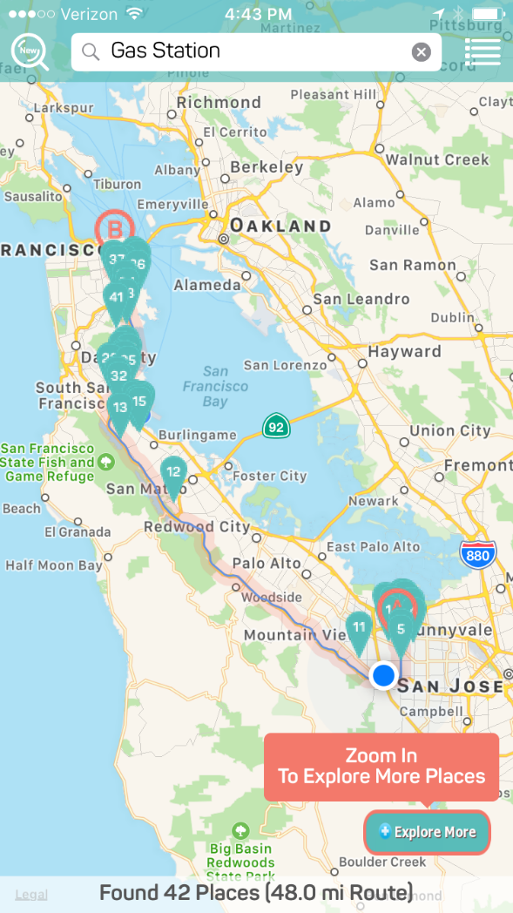
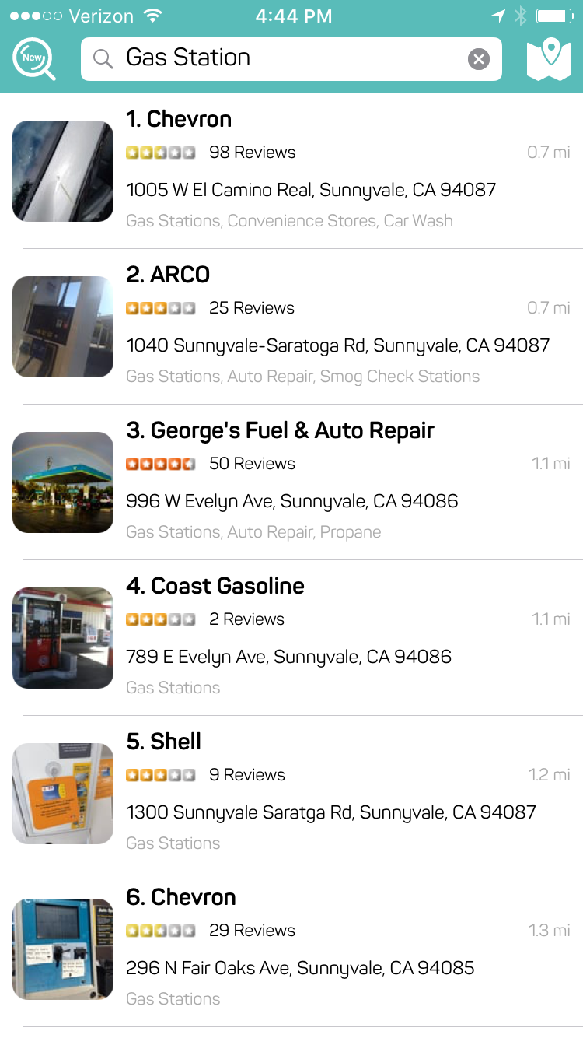
2, The route will first show up, then the candidate stops will show up within a certain range of the route. A more detailed query (such as thai restaurant) can be applied to limit the number of results. Both on the map and on a listview

Slide 3
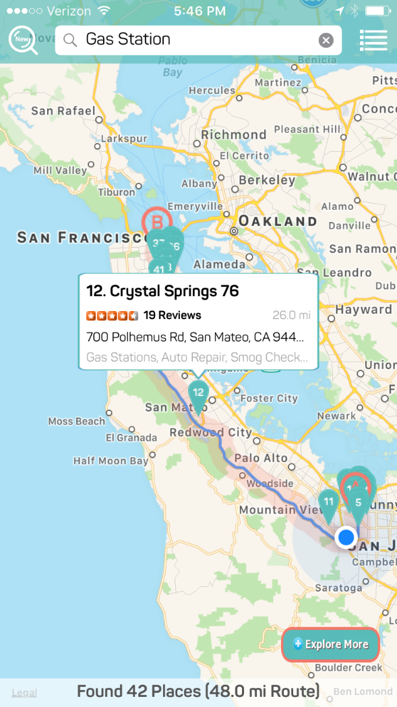
3, users can click on the candidate stops on the map then a highlight will pop up (such as location, rating, business hour, phone number etc.)

Slide 4
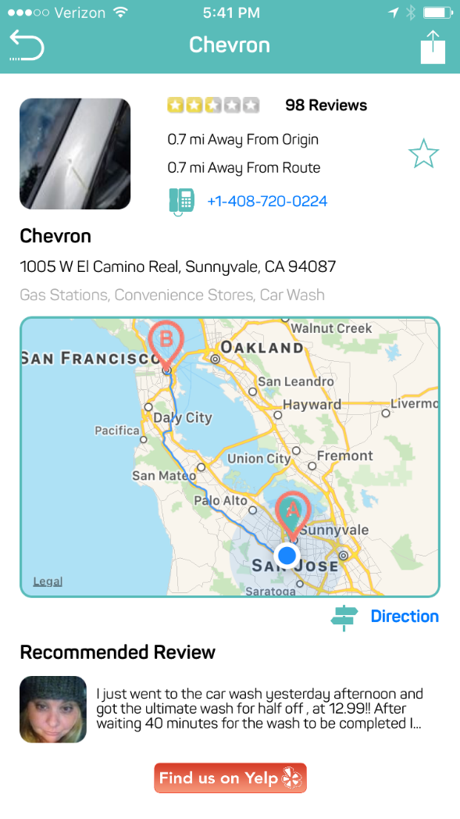
users can also click to get the list information of all possible stops and clicking item will present detailed information about the business

Slide 5
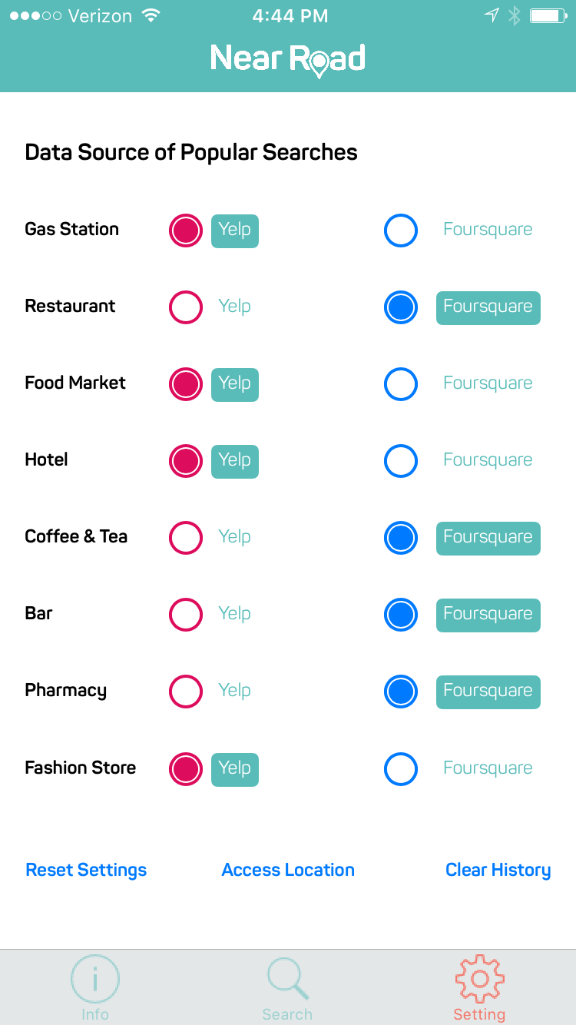
5, Setting is available to save preferences. there are general filters that can be applied such as minimum rating, search range, price range, data sources (yelp, foursquare or other resources), transportation types etc.

